Slide 1



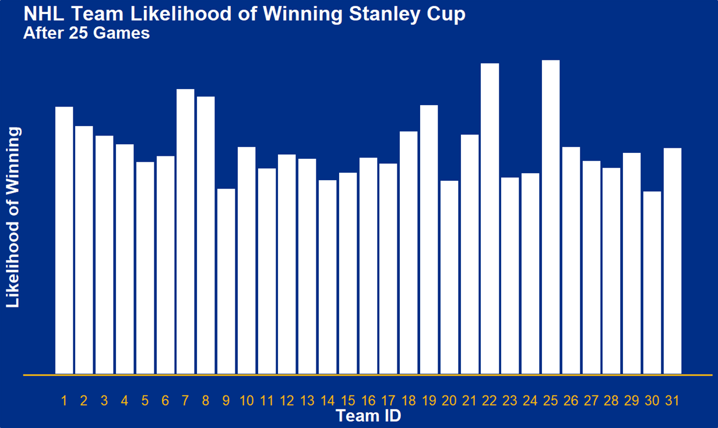
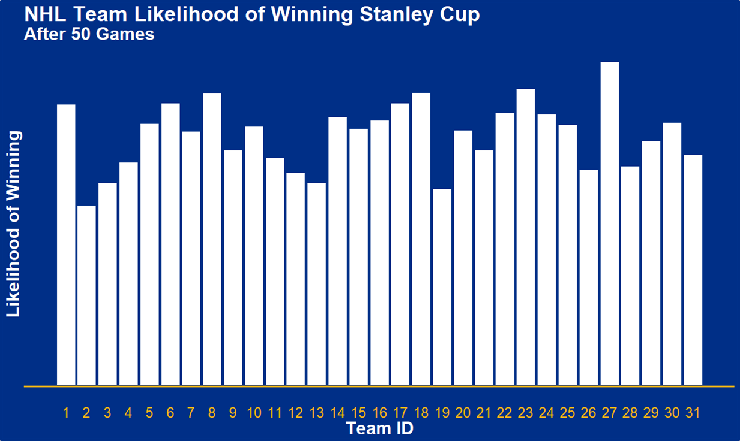
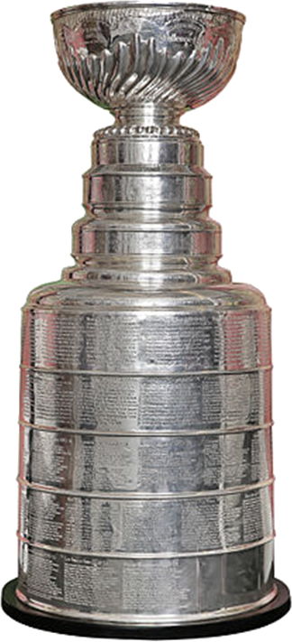

Never Tell Me the Odds!
What were the chances that the St. Louis Blues could go from Second-Last
to Winning the Stanley Cup?
Introduction
Constant Elo Ratings – 3 points in Time
In What Parallel Universe Could the Blues Win?
The National Hockey League comprised 31 teams in the 2018/19 season. The St. Louis Blues, based out of Missouri, were the team that took home the Stanley Cup after the long playoffs series.
What made the St. Louis Blues winning the Stanley Cup so exceptional was that they were ranked 30th out of 31 teams in the League after their 25th game, which was 14th out of 15 in the Western Conference and 7th out of 7 in the Central Division. From this point, the Blues managed to turn around their season to make it to the playoffs and eventually won the Stanley Cup. By their 50th game they were ranked 20th in the League, 10th in Conference, and 6th in Division. By the end of the regular season, 82 games, they clinched a playoffs position from 3rd in the Division, 5th in Conference, and 11th in League.
But exactly how unlikely was this turn around? After games 25 and 50, what were the St Louis Blues chances of making it to the playoffs and eventually winning the Stanley Cup? How does this compare to their chances at the end of the season? What were the chances of the St Louis Blues winning the Stanley Cup after games 25 and 50? Did this change compared to game 82?
A constant Elo model was used to create ratings for every team at three points in time; after games 25, 50, and 82. No home ice advantage was factored into the model, so the rating formula was:
$$E= \frac{1}{1+{10}^{\left(\frac{R_{b}−R_{a}}{400}\right)}}$$
The standard MS Solver was used to find team ratings that minimised the sum of the squares of the differences between predicted results (E above) and the actual results of each match. Data was partitioned twice based on the game numbers of both teams being more than 25 and then 50. All team ratings were centred around 1500.
After game 25, the team rating for the St. Louis Blues was found to be 1,389.5; 31st out of 31 in the League. After game 50, the St. Louis Blues had a team rating of 1472.0, which was 21st out of 31. At the end of the regular season, the team rating for St. Louis was 1535.4, which was 10th out of 31 teams.
The simulations found the likelihood of the St. Louis Blues winning the Stanley Cup from game 25 to be 1/1000. The Blues’ chances improved by game 50, which were 1/500. At the end of the regular season, with a position in the playoffs clinched, their chances were still only 1/200.
Simulation
Season Structure
Three simulations were run to match each of the partitions of data and each of the Elo team ratings. Using the ratings determined for games 1 to 25, games from 26 onwards were simulated. Similarly, using the Elo ratings for games 1 to 50, games from 51 onwards were simulated. For these two simulations the final standings, as determined by the simulation, were used to further simulate the finals series. The Elo ratings as determined for the entire regular season were also used to simulate the finals series. As such, three likelihoods were calculated; the likelihood of St. Louis winning the Stanley Cup at game 25, at game 50, and at game 82.
Each of the simulations were run across 10,000 trials. For each game within each trial a number was chosen at random from a uniform distribution between 0 and 1. If this number was lesser than the expected result of the match, Team A was determined to win the simulated game. Conversely, if the value of the random number was greater than the expected value, Team B was determined to win. This was repeated for each of the remaining games of the regular season and the finals series.
Points were determined for each of the simulated games in the remaining season to align with standard scoring in the NHL. Two points were awarded for a win and zero points for a loss. Ties in season points were broken by total goals scored over the season, with the team that scored more goals being ranked higher. These season rankings were used to decide the teams that progressed into the finals.
The playoffs series were decided by the same method as above, with expected results compared to a value from random number generator. Each winner progressed to the next stage, and ultimately the final playoffs series.
Limitations and Conclusions
Unlike many other sports, the NHL doesn’t strictly have rounds. As each team played 82 games in the regular season, this number does not divide evenly into the approximately 26 weeks that the season spans. As such, number of games played was used to calculate ranking position at given points within the season.
The NHL finals series brings together the two conferences within the League; Western and Eastern. The winners of the playoffs series within each conference then play each other in the Stanley Cup finals series. In each finals matchup, both teams play up to seven games, with the team to reach 4 wins progressing to the next stage.
Firstly, the model did not account for points awarded for Over Time Losses, which are awarded to the losing team when a game goes into overtime.
Secondly, the model assumed that there was only one game in each stage of the playoffs series. As such, the first-to-four nature of the playoffs series was not incorporated.
Lastly, data partitions were determined based on the game number of both teams. That is, many games where one team was playing their 26th game but the competitor was playing their 24th were excluded from partitions. More over, team standings were also determined based on similar methods, so often ratings for teams were determined at points in time where one team may have only just played their 25th game whilst others had played their 26th or more.
St. Louis Blues’ likelihood of both making it to and winning the Stanley Cup playoffs were slim throughout all points in the season, despite the dramatic increase in wins as the weeks progressed. Even after clinching a playoffs position at the end of the regular season, the Blues’ likelihood of winning each successive series was still low. They truly overcame the odds.
First Round
Second Round
Conference Finals
Stanley Cup Finals
Conference Finals
Second Round
First Round
1st Atlantic
1st Central
Wild Card Eastern
Wild Card Western
2nd Atlantic
2nd Central
3rd Atlantic
3rd Central
1st Metropolitan
1st Pacific
Wild Card Eastern
Wild Card Western
2nd Metropolitan
2nd Central
3rd Metropolitan
3rd Central

